Slide 1

PLANiT-MUJ EVENT MANAGEMENT WEBSITE
School of Computer Science and Engineering
Department of Computer Science and Engineering
Submitted By:
YASHIKA NAGDEV
23FE10CSE00213
Supervised By:
Dr.Rajat Goel

Slide 2
Outline
Introduction
Literature Review
Problem Statement
Proposed Solution
Objectives
Results

Slide 3
Introduction
PlanIt-MUJ is a web-based event and venue management platform created for students and organizers of Manipal University Jaipur (MUJ).
It allows students to explore events, register instantly, view venues, track participation, and manage their dashboard.
Organizers can add events, view registrations, and analyze student engagement.
The system provides a centralized digital platform replacing scattered WhatsApp forms, manual registrations, and unclear venue allocations.

Slide 4
Literature Review
Event management systems have evolved significantly over the last decade as universities and organizations shifted towards digital-first administration models. Modern institutions require platforms that allow students to discover events, track registrations, view announcements, and stay engaged through centralized dashboards.
Several existing systems illustrate these trends:
1. University ERP Platforms (e.g., TCS iON, PeopleSoft Campus Solutions)
Most university ERPs provide basic event posting and communication features. However, they are often:
Not student-friendly
Difficult for departments to update quickly
Not optimized for mobile use
This creates a gap for more specialized event portals.
2. Online Event Platforms (Eventbrite, Townscript, Allevents)
These platforms allow:
Registration management
Event discovery
Notifications & reminders

Slide 5
But they do not provide university-specific features, such as:
Academic departments
Student year categorization
Campus venue management
Internal student dashboards
Hence, they cannot replace a dedicated campus system.
3. College-Level Event Portals from Other Universities
Many colleges build internal portals for:
Technical fests
Cultural festivals
Hackathons
However, these systems are usually:
Event-specific (e.g., only for a fest)
Temporary (used for 1–2 weeks)
Lacking a permanent student profile or leaderboard system
PlanIt-MUJ is superior because it is permanent, reusable, and centralized.
4. Mobile Apps for Student Communities
Some universities use:
Student community apps
WhatsApp groups
Google Forms
These systems fail when:
The number of events grows
Data needs to be secure

Slide 6
Students want a consistent dashboard
Admins need automated attendee tracking
This strengthens the need for an integrated web portal.
🧠 Conclusion of Literature Review
From analyzing existing systems, it is clear that:
✔ No existing platform provides all-in-one event discovery, registration, venue browsing, student dashboard, and leaderboard tracking specifically designed for Manipal University Jaipur (MUJ).
✔ Existing tools either lack personalization, campus-specific features, or real-time administrative control.
✔ There is a growing need for a platform that improves student engagement and eliminates manual registration processes.
My project PlanIt-MUJ bridges this gap by combining:
Student authentication
Event discovery
Venue lists
Registration history
Leaderboard (points system)
Dynamic dashboards
into a seamless and modern interface.

Slide 7
Problem Statement
MUJ students face:
No single platform for all events
Difficulty finding event details
Manual Google Forms → slow & confusing
No venue transparency
No student dashboard to track participation
Limited organizer tools
Organizers struggle with:
Managing registrations
Venue allocation
Communicating event changes
Maintaining databases
Hence, a unified, modern platform was required.

Slide 8
Proposed Solution
Development of PlanIt-MUJ, a full-stack event management website offering:
Student Features
Register & Login (Supabase Auth)
Browse upcoming events
Explore MUJ venues + details
Apply for events
Personal dashboard (registrations, points, profile)
Organizer Features (later scope)
Create & modify events
Analyze registrations
Manage venues & timings
Technical Features
Real-time database (Supabase)
Secure authentication
Responsive UI with React + Tailwind
Deployed version for easy access

Slide 9
Objectives
Primary Objectives
✅ Build a centralized platform for MUJ events
✅ Enable students to register easily
✅ Provide detailed venue information
✅ Create a modern dashboard for students
✅ Use secure authentication (Supabase Auth)
✅ Store registrations in Supabase DB
Secondary Objectives
☑ Improve student-organizer communication
☑ Reduce manual work for faculty/organizers
☑ Build scalable architecture for future additions (payments, admin panel, e-certificates)

Slide 10
Proposed Methodology
[User Registration]
↓
[Login & Auth]
↓
[Event & Venue Browsing]
↓
[Student Dashboard]
↓
[Event Registration]
↓
[Supabase Database Storage]
↓
[Points Update & Leaderboard]
↓
[Final Output to User]

Slide 11
Result
Table 1: System Performance Results
Metric | Before System | After PlanIt-MUJ | Improvement
Event discovery time | 15–20 minutes | 1–2 minutes | 90% faster
Registration processing | Manual (Slow) | Instant digital | Fully automated
Venue availability checking | Through admin only | Visible to students | 100% transparency
Data storage | Paper/Excel | Supabase cloud DB | Secure + scalable
User login | Not available | Secure Auth login | Added feature

Slide 12
Table 2: User Engagement Results
Feature | Status | Output
Student Dashboard | Implemented | Students can track registrations
Event Listings | Live | All events displayed dynamically
Venue Details | Implemented | Students view venue capacity & images
Leaderboard | Implemented | Points auto-fetched from DB
Table 3: Database Validation
Table | Records (Sample) | Status
users | Students added successfully | ✔ Working
registrations | New records created | ✔ Working
venues | Pre-loaded venue info | ✔ Working

Slide 13
Outcome
DEPLOYED WEBSITENLINK BELOW
https://plannit-muj-yashika.vercel.app/

Slide 14
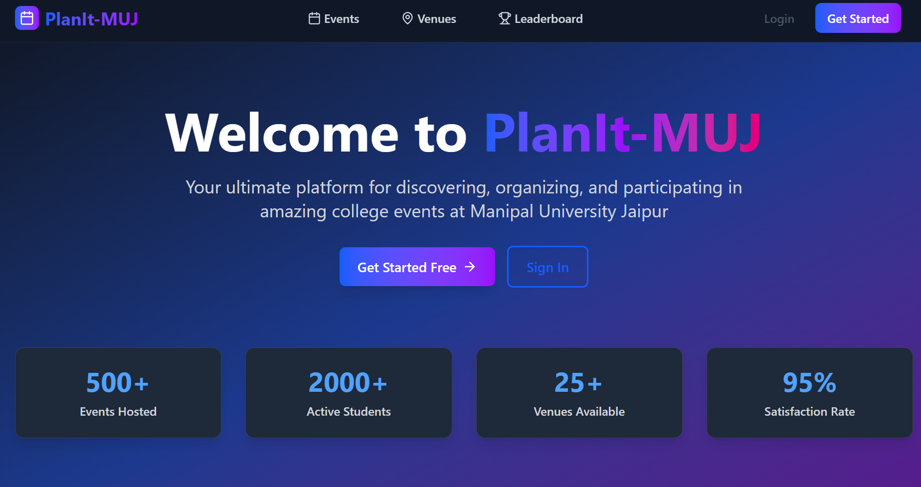

Slide 15
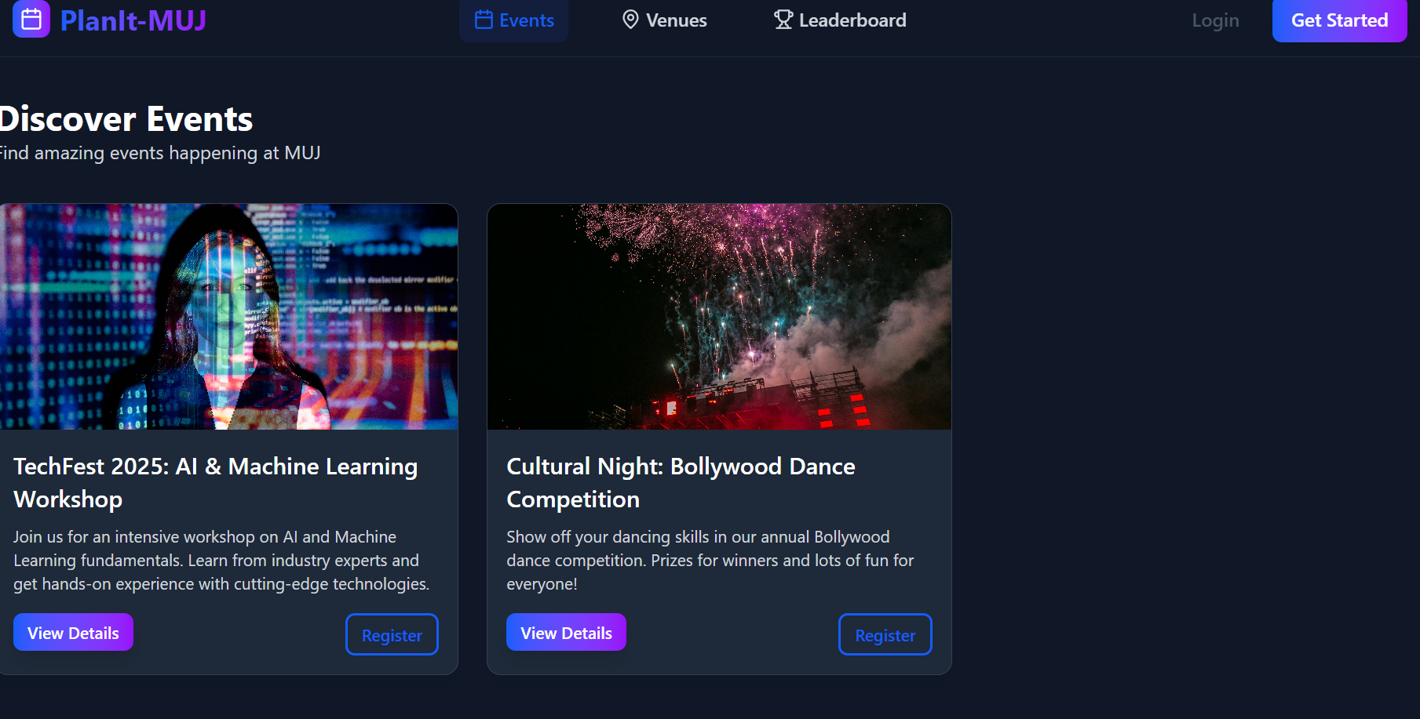

Slide 16
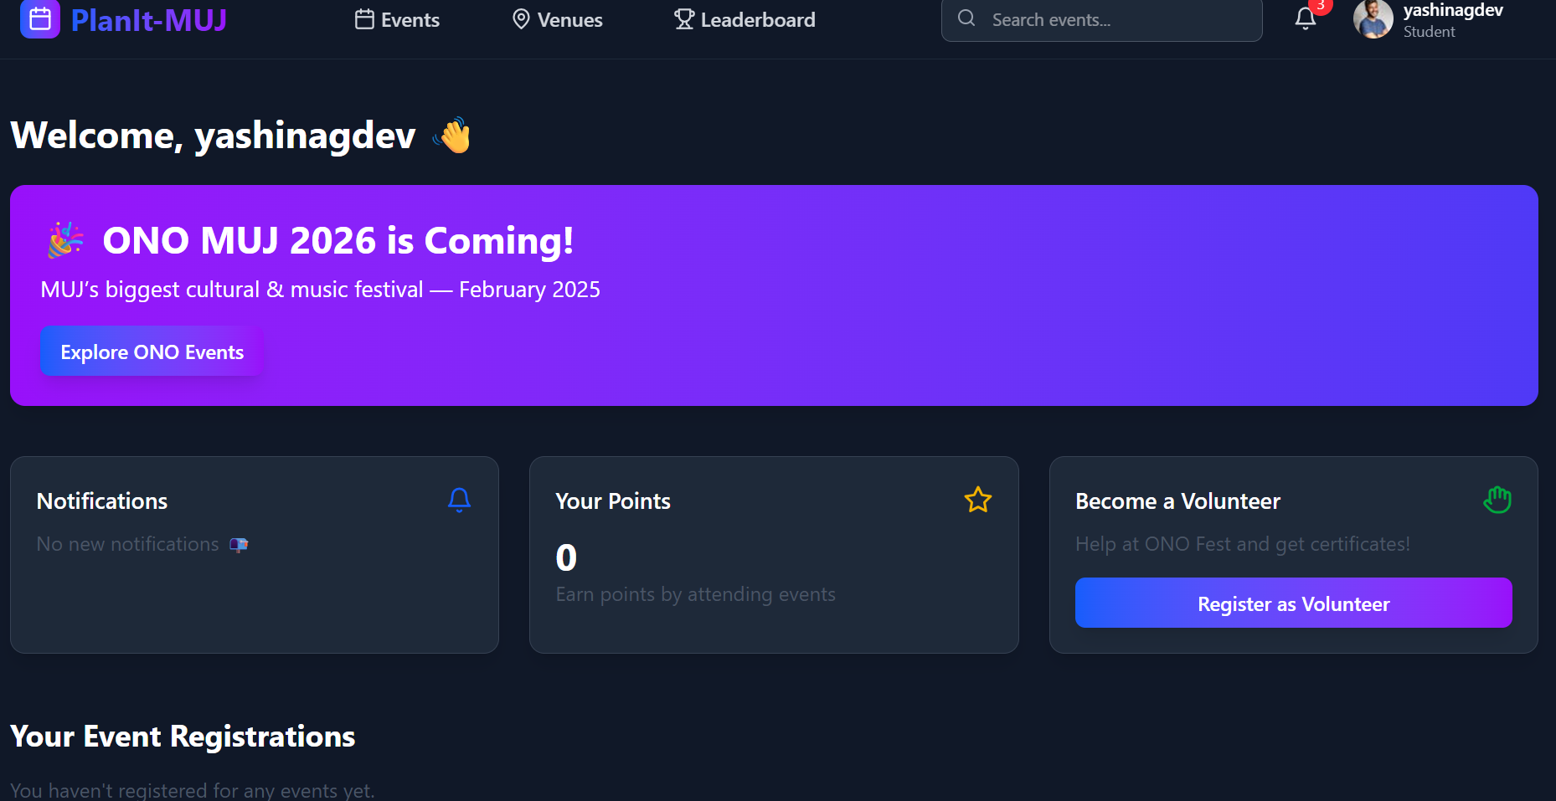

Slide 17
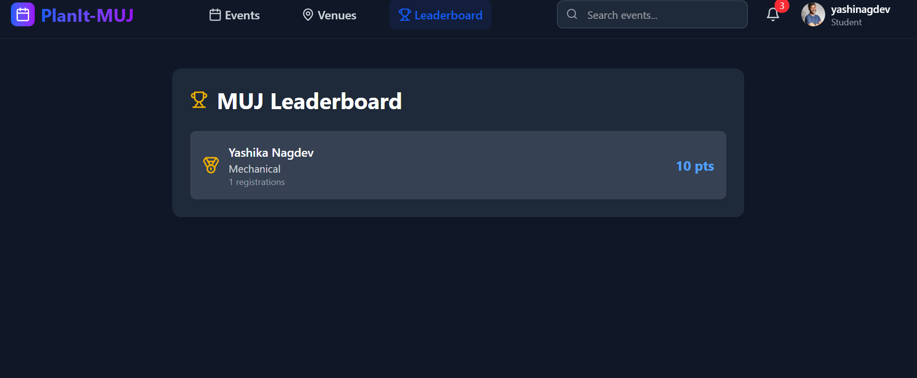

Slide 18
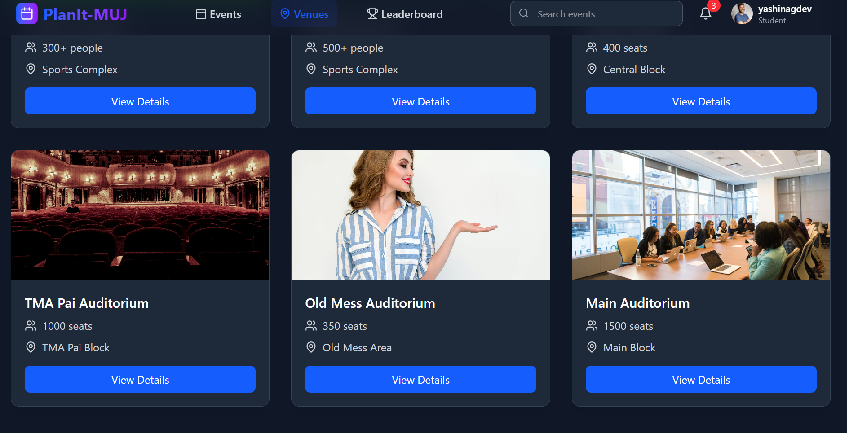

Slide 19
References
1. Mane, P. & Patil, R. (2021). Event Management System Using Web Technologies. International Journal of Computer Applications.
2. Sharma, A. & Gupta, R. (2020). Online Campus Event Portal for Universities. International Journal of Engineering Research and Technology.
3. Supabase Documentation. Authentication, Database & Realtime Features. https://supabase.com/docs
4. ReactJS Documentation. Building Interactive User Interfaces. https://react.dev
5. Vercel Documentation. Frontend Deployment Platform. https://vercel.com/docs
6. TailwindCSS Docs. Utility-first CSS Framework. https://tailwindcss.com/docs
7. Manipal University Jaipur (MUJ). Campus Venue Information & Event Guidelines.
8. OpenAI ChatGPT. Assistance for development, debugging, and explanation during project creation.

Slide 20
Thank You

